Slide 1


State Machine Diagrams

Slide 2



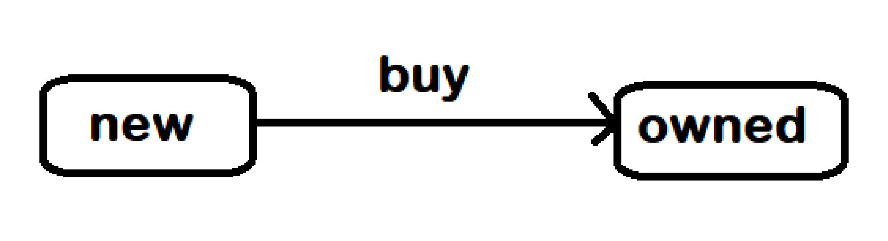
What are State Machine Diagrams?
UML state machine diagrams depict the various states that an object may be in and the transitions between those states.
Also called state-transition diagrams or even simply state diagrams.
Two kinds of state machines are defined in UML 2.4: behavioral state machine, and protocol state machine.

Slide 3
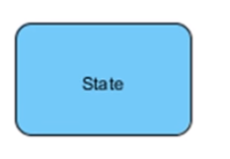
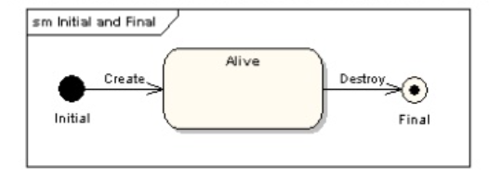
Notations
States - A state is a condition/situation an object in the system might be in. A state is denoted by a round-cornered rectangle with the name of the state written inside it.
Initial and Final States - The initial state is denoted by a filled black circle and may be labeled with a name. The final state is denoted by a circle with a dot inside and may also be labeled with a name.

Slide 4
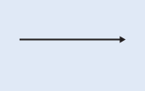
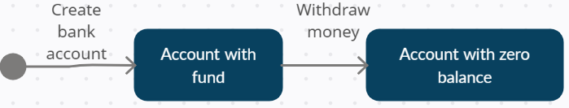

Notations
Transitions – A Transition is a progression from one state to another are denoted by lines with arrowheads. A transition may have a trigger.
An “event” is a noteworthy occurrence that triggers a change in state. The trigger is the cause of the transition. It is used to label the transitions.
A “Guard" is a condition which must be true in order for the trigger to cause the transition.

Slide 5
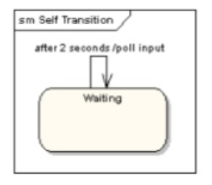
Notations
Self-Transitions - A state can have a transition that returns to itself, as in the following diagram. This is most useful when an effect is associated with the transition

Slide 6
Steps to draw a state machine diagram
Identify the States: The first step is to identify the various states that a selected objects will have over its lifetime.
Identify the Transitions: The next step is to identify the sequence of states that a selected object will pass through during its lifetime
Determine the events that cause the transitions: Label each transition with the trigger responsible for the state change. Mention the guard conditions, if any.

Slide 7
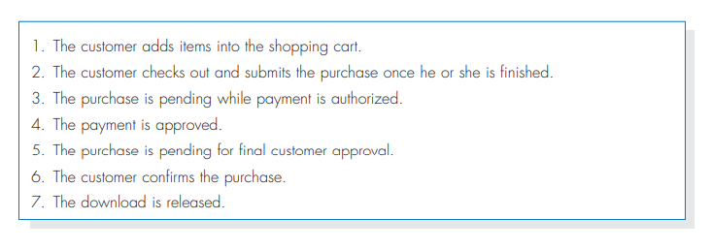
State of the selected tune from a Digital Music Download system.

Slide 8
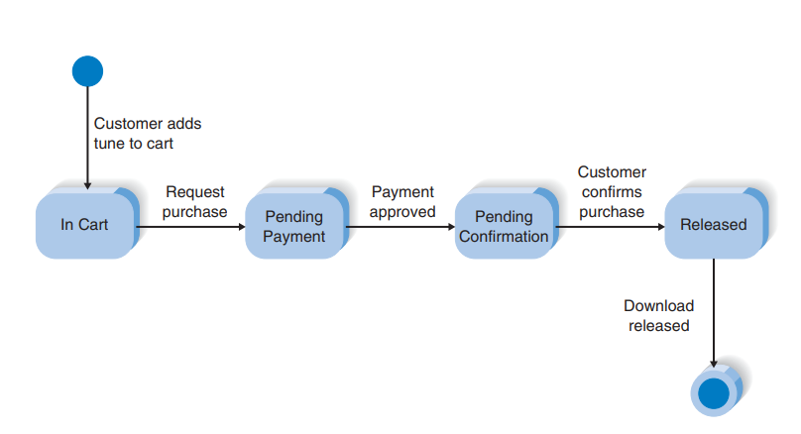
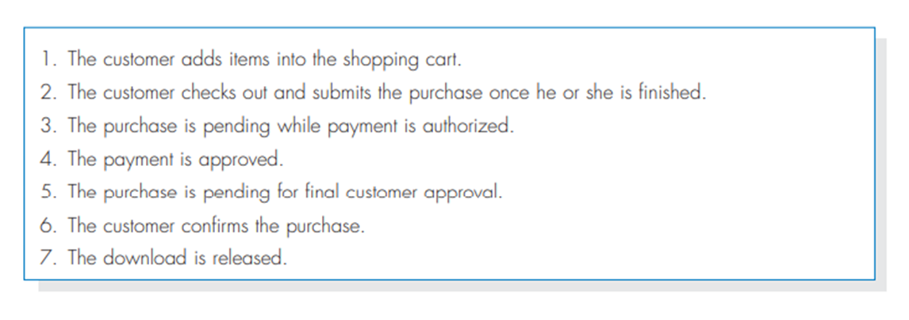
Example State Machine Diagram

Slide 9
Example State Machine Diagram

Slide 10
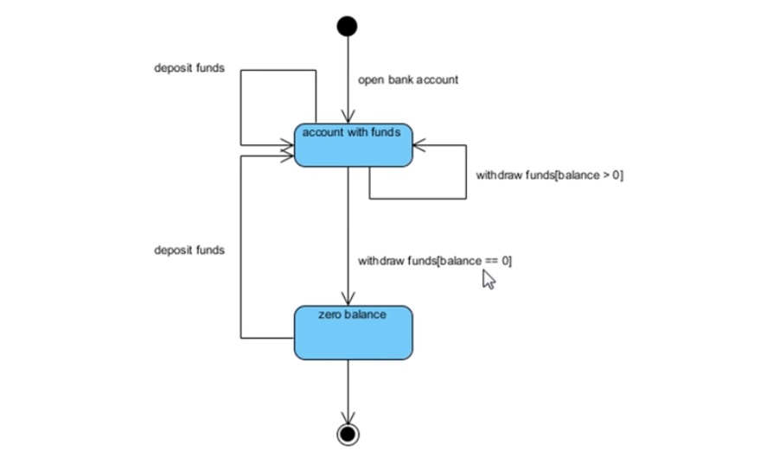
State Diagram of a Bank Account

Slide 11
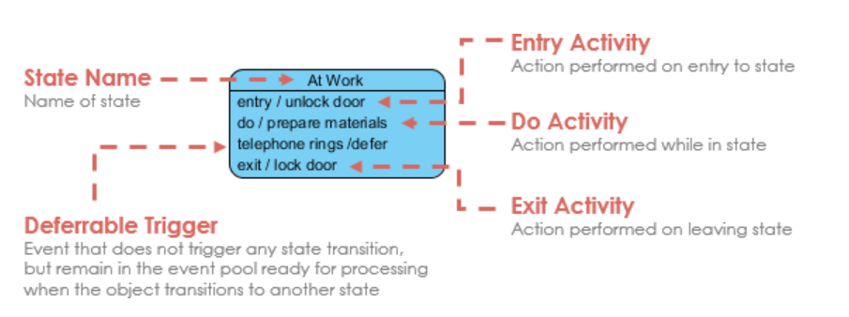
State Notation

Slide 12
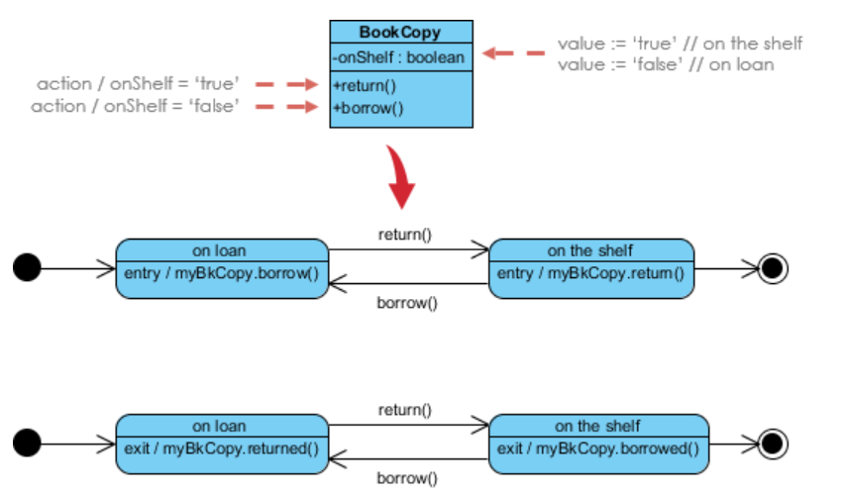
Entry / Exit Action (Check Book Status)

Slide 13
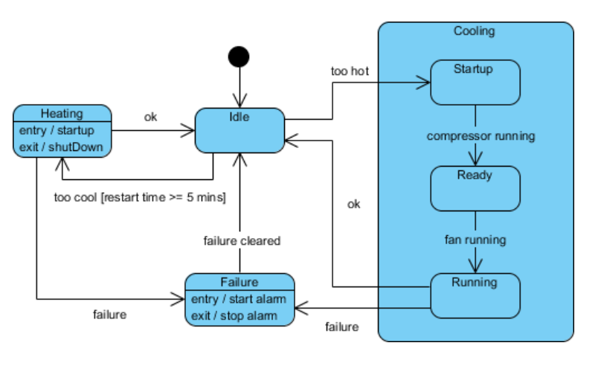
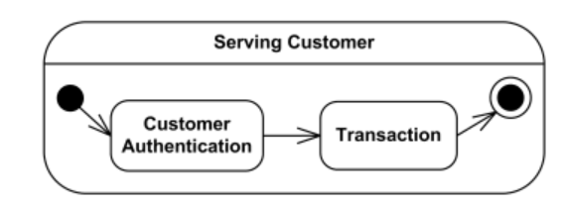
Substates (Composite state)

Slide 14
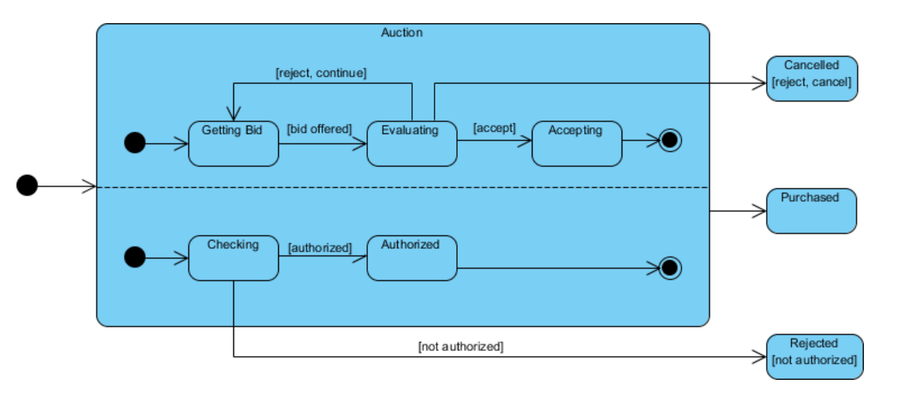
Concurrent State

Slide 15
Practice problem:
You have been working with the system for the campus housing service that helps students find apartments. One of the dynamic classes in this system likely is the apartment class. Draw a behavioral state machine diagram to show the various states that an apartment class transitions to throughout its lifetime.

Slide 16
Practice problem:
Every company having customers maintains customer accounts and supports a complete life cycle of the account from its creation until it is closed. There are differences in what are the stages (states) in the account's life cycle, and what are conditions or events causing account to change its state.
For the user account to be created, it has to meet some initial requirements. For example, user id (used as a login name) must be unique, at least for the existing accounts. After account was created, it might need to be verified. Verification depends on the company and could include e-mail, phone, and/or address verification. If account was not verified during some predefined period of time, that account could be moved to the suspended accounts. New, active, or suspended accounts could be cancelled at any time by client's request. Note, the precondition for this usually includes payment of any outstanding balances, and might require some separate account state or substate to handle this case.
User account might be suspended for security reasons, manually or automatically. For example, website intrusion detection system locks user account for predefined period of time, if there were several unsuccessful login attempts using incorrect account password. After account lock times out, account is activated back automatically.

